Slide 1



Date: 02/05/2025
Name: Arefeh Amidiyan
20XX
A Deep dive Into
Tennis Data
Analysis

Slide 2

Part 1
Introduction
Part 2
Analysis
Part 3
Final Takeaways & Strategic Recommendations
CONTENT

Slide 3
Introduction
Welcome to an insightful exploration of tennis data. In this presentation, we will explore key trends, player statistics, match durations, and the fascinating dynamics of left-handed and right-handed players. Our goal is to uncover data-driven insights that can help players, coaches, and analysts improve performance and strategy.

Slide 4
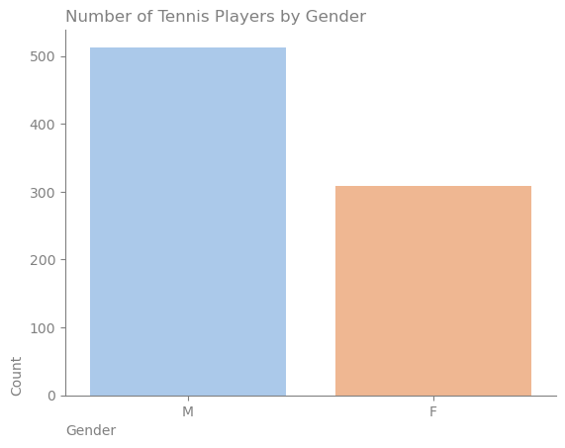
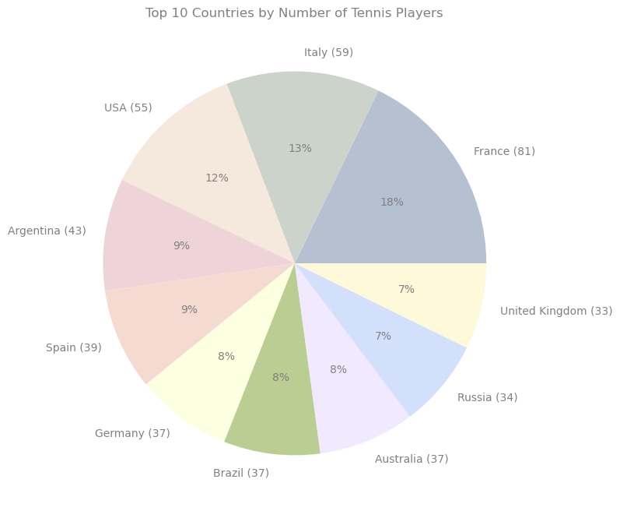
The Landscape of Tennis Players
Analysis:
The global representation of players spans 70 countries, with France, Italy, and the USA leading.
A near-equal distribution of male and female players suggests a balanced competitive environment.
Number of Tennis Players : 596
Countries Has Tennis Players : 70
📌 Why It Matters? Understanding player demographics helps federations and sponsors make informed decisions regarding talent development.

Slide 5
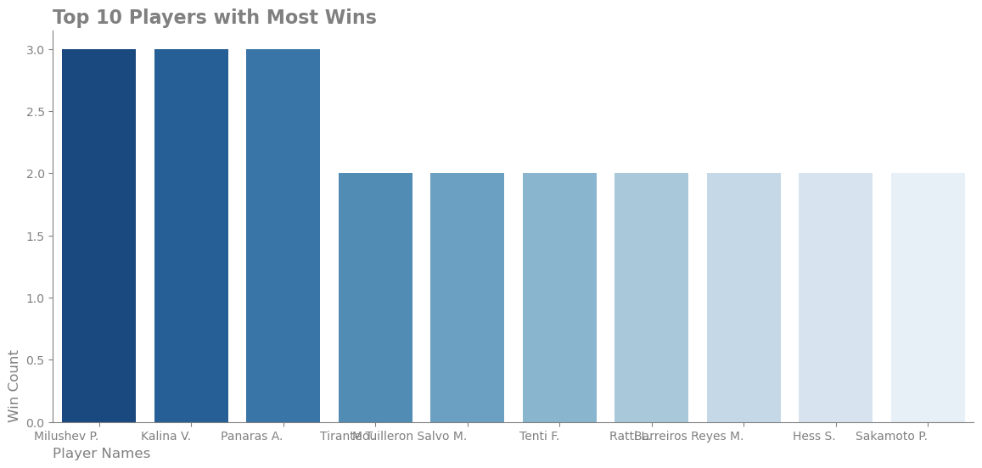
Analysis:
Identifying top-performing players provides insights into dominant playing styles.
Kubka M. leads in tournament wins, showcasing consistency in performance.
Competitive Performance - Who Dominates?
Top 10 Players with Most Wins
Player with Most Tournament Wins: Kubka M. (ID: 294815)
📌 Why It Matters? Knowing who dominates helps brands, coaches, and investors strategize around endorsements and training programs.

Slide 6
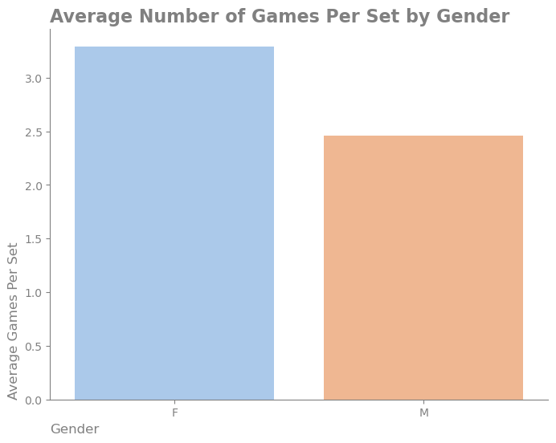

Match Duration & Intensity
Longest Match: 213.92 minutes (Match ID: 11699235)
Average Match Duration: 100.40 minutes
Average Games per Set by Gender
Analysis:
A typical match lasts around 100 minutes, but extreme cases reach over 200 minutes.
The number of games per set shows slight variation between men’s and women’s matches.
📌 Why It Matters? Match duration impacts player fatigue, tournament scheduling, and broadcast planning.

Slide 7

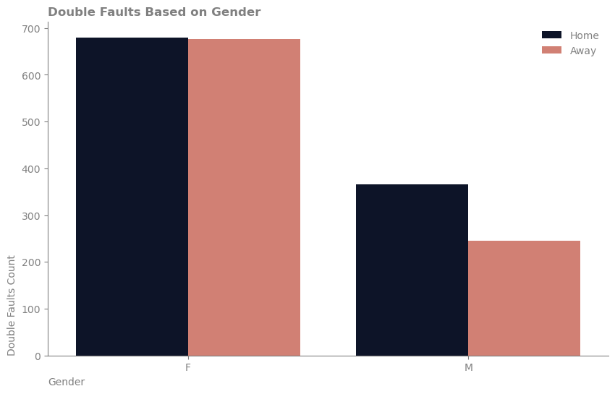
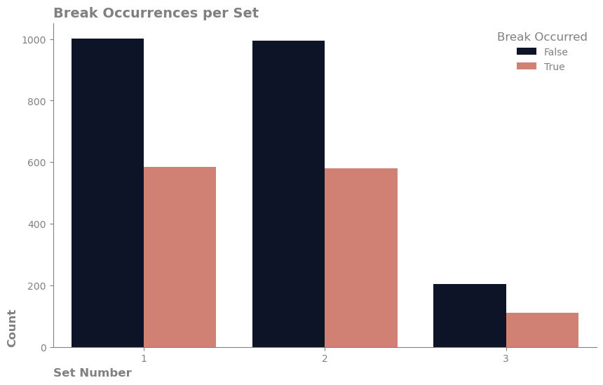
Playing Style & Strategy Insights
Average Number of Aces per Match: 8.00
Double Faults Based on Gender: home(f:680,m:336) away(f:677, m:245)
Break Occurrences per Set
Service Break Percentage: 36.65%
Analysis:
Aces and break points define a player’s aggressiveness vs. defensive play.
Home vs. Away performance: Players tend to break serve more frequently when playing away (8326 vs. 8026 home breaks).
📌Why It Matters?
Coaches can refine player training based on ace rates and break point effectiveness.
Betting analytics and predictive models benefit from such breakdowns.

Slide 8

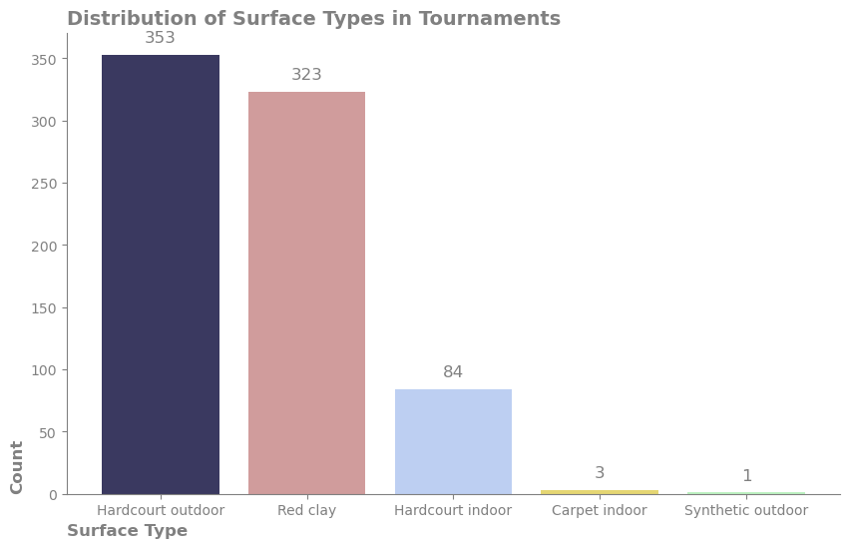
Surface Type & Game Dynamics
Most Common Surface: Hardcourt Outdoor (353 Tournaments)
Distribution of Surface Types: Red Clay, Carpet Indoor, Synthetic Outdoor
Analysis:
Surface type affects playing style—clay courts favor defensive play, while hardcourts support powerful serves.
Players should adapt strategies based on surface-specific dynamics.
📌 Why It Matters? Tournament organizers and sponsors can optimize event selection based on player performance on different surfaces.

Slide 9
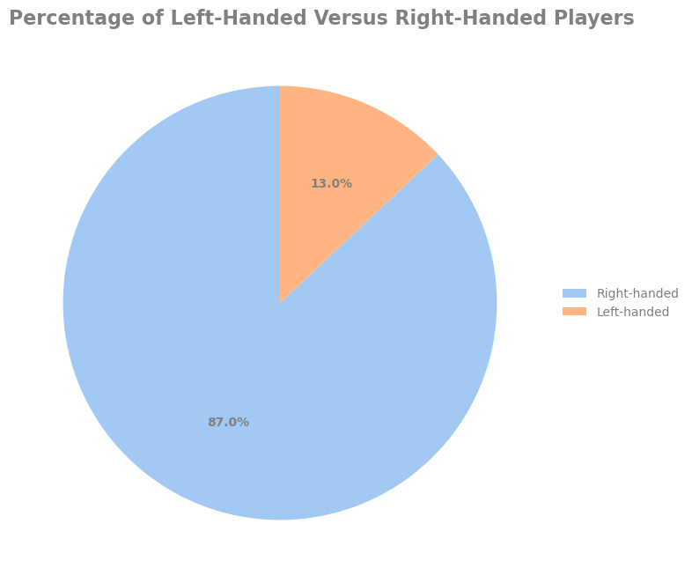
Right vs. Left-Handed Players - Analyzing Trends
Right-Handed Players: 87.2%
Left-Handed Players: 12.8%
Analysis:
Left-handed players are significantly fewer but may have a strategic advantage against right-handers.
Training regimens should consider left-handed opponents for better preparation.
📌 Why It Matters?
Helps coaches prepare players for diverse playing styles.
Left-handed players may have higher sponsorship value due to uniqueness.

Slide 10
Betting & Success Metrics
Total Bets: 848 | Successful Bets: 418
Success Ratio: 49.29%
Analysis:
A nearly 50% success rate indicates a balance in predictability.
Factors like player fatigue, opponent ranking, and court type influence success rates.
📌 Why It Matters?
Essential insights for sports betting platforms &
investors looking to improve prediction accuracy.

Slide 11

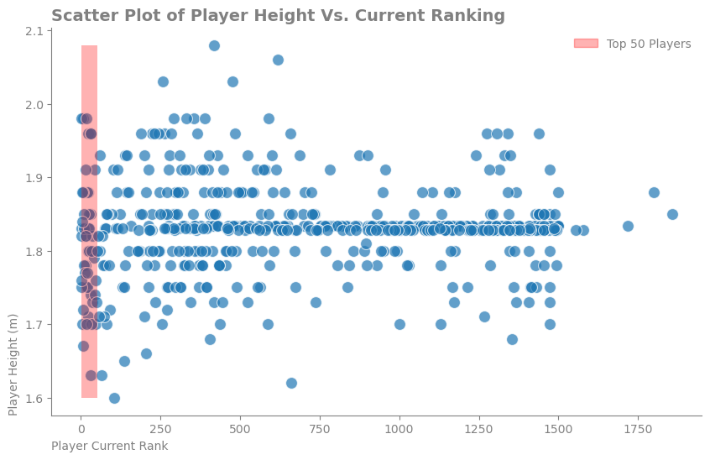
Correlation Analysis
- Height & Ranking
Correlation between Height & Ranking: 0.03 (Very Weak)
Analysis:
Height does not significantly influence a player’s ranking.
Strategy, skill, and endurance play a larger role in success.
📌 Why It Matters?
Breaks the myth that taller players always have an advantage.
Focus should remain on technical ability rather than physical traits.

Slide 12
Final Takeaways & Strategic Recommendations
📌 Key Business & Strategic Insights:
Talent Scouting:
Identifying promising players based on win rates,
ace counts, and endurance.
Tournament Management:
Optimizing scheduling based on match duration
and fatigue factors.
Sponsorship & Media Rights:
Leveraging insights on top players, playing styles,
and high-engagement matchups.
Data-Driven Training:
Coaches should customize training plans based
on ace percentages, court preferences,
and left vs. right-handed trends.

Slide 13
Thanks for watching

